Slide 1
Part 3: CONNECTING WITH CUSTOMERS
Chap 5: Creating Long-Term Loyalty Relationships
Chap 6: Analyzing Consumer Markets
Chap 7: Analyzing Business Markets
Chap 9: Identifying Market Segments and Targets

Slide 2
Section 1:
Chap 5
Building Customer Satisfaction, Value & Loyalty
Maximizing Customer Lifetime Value
Cultivating Customer Relationships
Customer Database & Database Marketing

Slide 3
Building Customer Value, Satisfaction & Loyalty Customer Perceived Value
Organization’s hierarchy – yesterday (▼) & today (►)
CUSTOMERS
Front-line people
Middle Management
Top Management
Traditional Organizational chart
CUSTOMERS
CUSTOMERS
Top Management
Middle Management
Front-line people
CUSTOMERS
Modern-day, customer-oriented Organizational chart

Slide 4
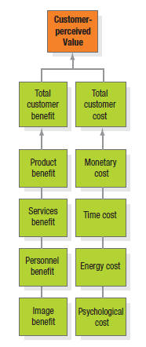
Building Customer Value, Satisfaction & Loyalty Customer Perceived Value
Customer Perceived Value (CPV) is the difference between the prospective customer’s evaluation of all the benefits and all the costs of an offering and the perceived alternatives
How customer values offering? Examples & CPV>>

Slide 5
Building Customer Value, Satisfaction & Loyalty Customer Perceived Value
Delivering High Customer Value
Loyalty – a deeply held commitment to re-buy or re-patronize a preferred product or service in the future despite situational influences and marketing efforts having the potential to cause switching behavior.
Stay with brand: whatever happens!
How to achieve Loyalty => Deliver Profitable Value
Value proposition: benefits company promises to deliver
Value delivery system: experiences while obtaining and using the offering

Slide 6
Building Customer Value, Satisfaction & Loyalty Total Customer Satisfaction
Satisfaction
A person’s feelings of pleasure or disappointment resulting from comparing a product’s perceived performance in relation to his/her expectations
Ultimate aim of company is to deliver a high level of satisfaction
How expectations form?
Past buying experiences
Friends’ and associates advice
Marketers’ (and competitors’) information
Managing expectation => Not too high and not too low

Slide 7
Building Customer Value, Satisfaction & Loyalty Measuring Satisfaction
Since Satisfaction => Retention
So: measure it regularly
Ways of measuring satisfaction
Periodic surveys
Monitoring Customer Loss rate
Mystery shopping
Monitor Competitors’ performance in comparison
Customer Satisfaction is both a goal and a marketing tool

Slide 8
Building Customer Value, Satisfaction & Loyalty Product & Service Quality
Quality is:
Totality of features and characteristics of a product or service that bear on its ability to satisfy stated or implied needs
Marketing Manager’s role in Quality formulation
Participate in formulating strategies to help company win through total quality excellence
Deliver a Quality Marketing Program – Every marketing activity in itself is a quality activity i.e. performed at high standards
(SELF-READ exercise: Marketing Memo: Marketing & Total Quality, Pg 132)

Slide 9
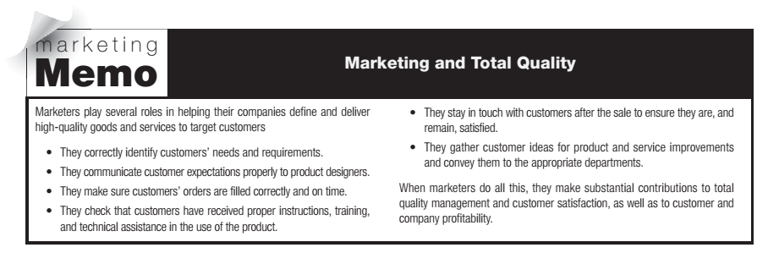
Self-read (included in course)

Slide 10
Building Customer Value, Satisfaction & Loyalty TQM
Total Quality Management is an organization-wide approach to continuously improving the quality of all the organization’s processes, products and services
“Quality is our best assurance of customer allegiance, our strongest defense against foreign competition and the only path to sustained growth and earnings” - John F. Welch Jr. Ex-Chairman, GE
Problem with TQM:
Overly focused on production, processes ; Lose sight of customer needs and wants
How marketers help in delivering high quality goods and services
Stay engaged and updated with customers all along from identifying needs to delivering to servicing…
TOPIC is not present in 14/e but is included – Use slide only to review

Slide 11
Maximizing Customer Lifetime Value Overview
Another way of looking at Marketing (Meeting needs profitably) => Marketing is the art of attracting and keeping profitable customers
Always identify whether large customers are proportionally profitable or smaller are, and define focus accordingly

Slide 12
Maximizing Customer Lifetime Value Customer Profitability
Profitable Customer A person, household or company that over time yields a revenue stream that exceeds by an acceptable amount the company’s cost stream of attracting, selling and servicing that customer
Customer Profitability Analysis to identify in “minute” detail what is the actual cost to customer while earning revenue
Every activity is monitored – Use ABC (Activity-Based Costing)
Segment Customers (profit-wise) as: (a) Most Profitable, (b) Profitable, (c) Low Profitable but desirable, (d) Low Profitable and Undesirable
Competitive Advantage is a company’s ability to perform in one or more ways competitors cannot or will not match.
Generally not sustainable (although desired)
It must always be a “customer advantage” (something a customer values)

Slide 13
Maximizing Customer Lifetime Value Measuring Customer Lifetime Value (CLV)
CLV
Net Present Value of the stream of future profits expected over the customer’s lifetime purchases
Use Discounted Cash Flows (apply Time Value of Money)
Analysis of all revenues and costs estimated for lifetime engagement
It is a challenging task to estimate so many variables over whole of customer’s engagement with company
Still, marketers need to be careful that short-term, brand-building activities are not missed

Slide 14
Cultivating Customer Relationships Overview
14
To maximize Customer [Lifetime] Value:
Cultivate Long-term relationships
Moving from Wasteful mass marketing to Precision marketing for Stronger customer relationships
Use information technology to be close to customers

Slide 15
Cultivating Customer Relationships Customer Relationship Management (CRM)
15
CRM: Process of managing detailed information about individual customers and carefully managing all customer’s “touch-points” to maximize customer loyalty
Personalizing Marketing: Framework for one-to-one marketing
Identify your prospects and customers
Differentiate customers in terms of: (1) their needs and (2) their value to company
Interact with individual customers to improve knowledge about their needs
Customize Products, Services and Messages for each customer
Customer Empowerment
Customer Reviews & Recommendations

Slide 16
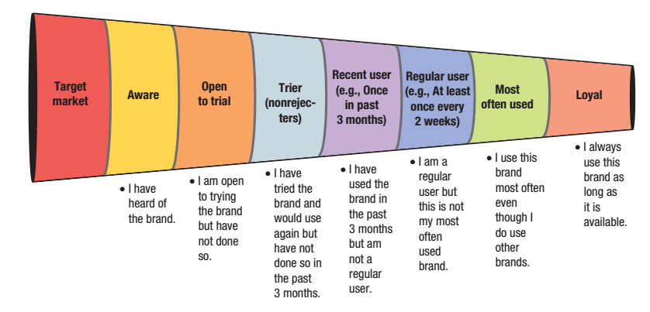
Cultivating Customer Relationships Attracting, Retaining and Growing Customers
16
Retention dynamics
Define and measure company retention rate (retention is opp. of defection)
Distinguish the causes of customer attrition and identify those that can be managed better
Compare the lost customer’s lifetime value to the costs of reducing the defection rate
Marketing Funnel: Learning about the ‘loss rate’ as customer moves towards loyalty

Slide 17
Cultivating Customer Relationships Forming Strong Customer Bonds
17
Adding Financial Benefits
Frequency Programs
reward those who buy more
Club Marketing
Social Benefits
Personalized services
Structural Ties
Contracts
Lower Prices and Better Services

Slide 18
Customer Database & Database Marketing Key concepts only
18
Customer Database vs. a mailing list
Database Marketing
Uses (General review)
Downside
Cost for building a database
Difficult to get everyone in company on board
Not all customers want to have relationship with company and share information
Assumptions might be faulty

Slide 19
Section2:
Chap 6
What influences consumer behavior
Key Psychological processes
The Buying Decision process

Slide 20
What Influences Consumer Behavior
20
Understanding the Theory and Realities of Consumer Behavior
A key part of Marketing
Consumer’s buying behavior is influenced by:
Cultural Factors
Social Factors
Personal Factors

Slide 21
What Influences Consumer Behavior Cultural Factors
21
Culture Subculture & Social Class: 3 important variables
Culture is fundamental determinant of a person’s wants and behavior
Set of values, perceptions, preferences, and behaviors through his or her family or other institutions

Slide 22
What Influences Consumer Behavior Cultural Factors
22
Each Culture has smaller Subcultures => more specific identification and socialization
Significantly affluent Subcultures => Marketers considering marketing accordingly (i.e. multicultural marketing), else not very profoundly observed
Tapal Danedar – a national brand by Tapal (culture)
Tapal Mezban – a ‘Sindhi’ brand by Tapal (subculture)
Tapal Tezdam – a ‘Punjabi‘ brand by Tapal (subculture)

Slide 23
What Influences Consumer Behavior Cultural Factors
23
Social Stratification – strata(s) in society
Social Classes Relatively homogenous and enduring divisions in each society, which are hierarchically organized and whose members share similar values, interests and behavior
Characteristics:
Tend to behave similarly
Defines position in society
Defined by many variables together (no one variable like income to define it)
Individuals move up or down in classes

Slide 24
What Influences Consumer Behavior Social Factors
24
Reference Groups consist of all groups that have a direct (face-to-face) or indirect influence on his/her attitudes or behavior
Primary Groups – more interactivity, informal (Family, friends)
Secondary Groups – Less interactivity, formal (religious, political)
Important Groups to which people do not belong
Aspirational Group – A person hopes to join
Dissociative Group – Whose value a person rejects
Opinion leader - A person in informal, product-related communications who offers advice or information about specific product or product category
Polio eradication campaign: Whom will you target as an ‘opinion leader’ in a city’s UC and a village

Slide 25

What Influences Consumer Behavior Social Factors
25
Family – Most important Consumer buying organization in the society. Most influential primary reference group
Marketers are interested in roles and relative influence of family members in purchasing behavior
Can directly impact a sale
Family eating out:
Father (Chinese – Tai Wah)
Mother (Healthy – Subway)
Grandparents (Continental – Village)
and the winner is:
BACHAY: Hum ne Pizza Hut jana hai!!!

Slide 26
What Influences Consumer Behavior Social Factors
26
There can be different roles for a person in different settings
Role: Activities a person is expected to perform
Status: carried by every role (Role implies/leads to Status)
Understanding of Roles and Status is important for understanding buying behaviors

Slide 27
What Influences Consumer Behavior Personal Factors
27
Different personal factors
Age and stage in life cycle
Occupation and economic circumstances
Personality and self-concept
Lifestyle and Values

Slide 28
What Influences Consumer Behavior Personal Factors
28
Age & Stage in Life Cycle
Preferences and consumer behaviors change with age
Important considerations include:
Family Life Cycle – As it grows in years and numbers
Psychological Life Cycle – As a person grows
Critical Life Events – Births, marriage, relocation

Slide 29
What Influences Consumer Behavior Personal Factors
29
Occupation & Economic Circumstances
Occupation also impacts buying behaviors
Engineers, IT will be more inclined towards latest gadgets & other ‘technology-based’ solutions
Economic Considerations
Spendable income
Savings and Assets
Debts and Borrowing Power
Attitude towards spending and saving

Slide 30
What Influences Consumer Behavior Personal Factors
30
Personality and Self-Concept
Personality – Set of distinguishing human psychological traits that lead to relatively consistent and enduring responses to environmental stimuli
Very useful in analyzing consumer brand choices
Brand Personality – Specific mix of human traits that may be attributed to a particular brand
Strong relation in choosing brand’s consistent with either:
Actual self-concept
Ideal self-concept

Slide 31
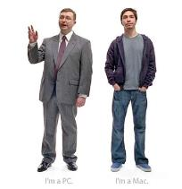


What Influences Consumer Behavior Personal Factors
31
Apple Ads: A classic case of ‘Ideal Self’ personified
See on Youtube: Apple’s classic campaign – I’m a Mac and I’m a PC
A tribute to Steve Jobs – The Marketing Genius

Slide 32
What Influences Consumer Behavior Personal Factors
32
Lifestyle and Values
Lifestyle – Person’s pattern of living in the world as expressed in activities, interests and opinions
Lifestyles partly shaped by:
Time-constraints
Money-constraints
Core Values: They are the belief systems that underlie consumer attitudes and behaviors and strongly influence consumer behavior

Slide 33
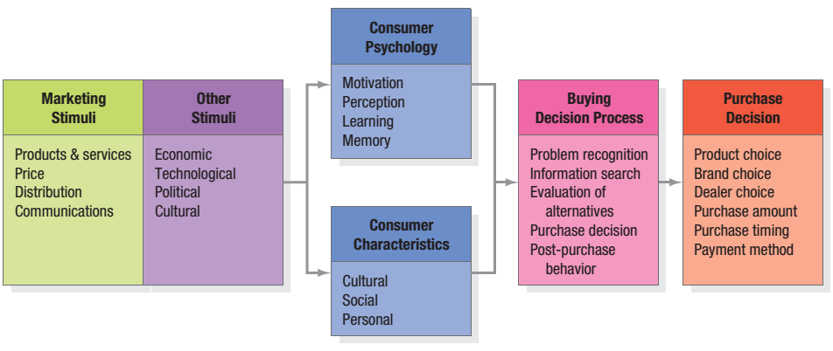
Key Psychological Processes
33
(1) Motivation (2) Perception (3) Learning (4) Emotions (5) Memory
These (Psychological Processes) are part of Stimulus-Response model

Slide 34
Key Psychological Processes Motivation
34
Needs & Motives
Needs can be:
Biogenic (hunger, thirst etc)
Psychogenic (need for self-recognition, self-esteem)
Motive
Need with a sufficient intensity pressing a person to “act”
Theories of Human Motivation:
Freud
Maslow
Herzberg

Slide 35
Key Psychological Processes Motivation
35
Theories of Human Motivation | Freud
Psychological forces are largely unconscious
A person cannot fully understand his/her own motivations
Marketers try to understand what all “motives” a product can satisfy
Why we buy ‘branded’ stuff? Reliability? Quality? Status Symbol?

Slide 36
Key Psychological Processes Motivation
36
Theories of Human Motivation | Maslow
Human needs are arranged in hierarchy
Most to Least pressing
Marketers try to understand how their product fit in a person’s life and goals
Self-Actualization Needs (self-development and realization)
Esteem Needs (Self-esteem, recognition, status)
Social Needs (sense of belonging, love)
Safety Needs (security, protection)
Physiological Needs (Food, Water, Shelter)

Slide 37
Key Psychological Processes Motivation
37
Theories of Human Motivation | Herzberg
Satisfiers and Dissatisfiers
Absence of Dissatisfiers + Presence of Satisfiers is required for motivation to buy
The new sunglasses are NOT expensive + they ARE branded ....motivating enough to be bought

Slide 38
Key Psychological Processes Perception
38
How a “motivated” person actually acts depends on:
Perception: The process by which an individual selects, organizes and interprets information inputs to create a meaningful picture of the world
Perception actually affects consumers’ behaviors
Three key perceptual processes
Selective Attention – People “selectively attend” to messages
Selective Distortion – “Distort” information about a brand as “I” think it is
Selective Retention – Remember good points about products we like rather good points of all products
Subliminal Perception? – Controlling the subconscious of consumer by subliminal messages – not proven

Slide 39
Key Psychological Processes Learning
39
Learning - Changes in an individual’s behavior arising from experience
Most human behavior is “learned” - Learning is an interplay of:
Drive – strong internal stimulus impelling action
Cues – Minor stimuli determining when, where and how a person respond
Responses – result of Drive and cues
Reinforcement – based on experience, response may be reinforced
Tendency to “generalize”
Apple makes good cellphones; therefore all products (including online TV streaming services) by Apple are also good! – Opportunity: making use of a ‘brand’
Discrimination – a person has learned to recognize differences in sets of similar stimuli and can adjust responses accordingly

Slide 40
Key Psychological Processes Emotions
40
Apart from rational and cognitive responses by consumers – Consumers responses may be emotional
A brand or product may make a consumer feel: proud, excited or even confident
Similarly, an Ad/communication may create feelings of amusement, disgust or wonder

Slide 41
Key Psychological Processes Memory
41
STM – temporary repository of information
LTM – more permanent repository of information
Associative Network Memory model vis-à-vis consumer brand knowledge => consumer brand knowledge might consist as a brand node in consumer’s mind with a variety of association
Brand associations consists of all brand-related thoughts, feelings, perceptions, images, experiences, beliefs etc…
Marketers need to ensure right experiences are created for their brand so it stays “rightly” in memory

Slide 42
Key Psychological Processes Memory
42
Two Memory Processes
Memory Process | Encoding
How and where information gets into memory
More attention placed on information => stronger the resulting association in memory
Existing brand associations also impact encoding process for newly formed associations
Memory Process | Retrieval
How information comes out of memory
Key factors affecting the process:
Presence of other product information
Delay from exposure to info at encoding
Information may be available but may require “retrieval cues or reminders” to be retrieved

Slide 43
The Buying Decision Process
43
The Five-Stage Model
A Psychological Process which needs to be understood by Marketers
Problem Recognition
Information Search
Evaluation of Alternatives
Purchase Decision
Post-Purchase Behavior

Slide 44
The Buying Decision Process Stage 1: Problem Recognition
44
A buyer recognizes a problem……i.e. “a need”
Either stimulated by
Internal Stimuli (Hunger, Thirst, Tiredness)
External Stimuli (Seeing an ad)
Marketers:
Need to identify circumstances that trigger a particular need
Can Devise campaigns to generate external stimuli Particularly for high-end, luxury items

Slide 45
The Buying Decision Process Stage 2: Information Search
45
An aroused/interested consumer will be inclined to search for more information
Now (s)he wants to buy and is looking for information
Two levels of interest:
Milder: Heightened Attention (pays attention to communication)
Sharper: Active information search (finding information)
Information sources:
Personal
Commercial (most frequent)
Public
Experiential
Role of internet

Slide 46
The Buying Decision Process Stage 2: Information Search
46
Information Sets (buying a LCD TV)
Total Set
ALL THE BRANDS
Awareness Set
WHICH I KNOW
Sony
Consideration Set
WHICH I CAN BUY
Sony
Choice Set
WHICH I “LIKE”
Decision
MY FINAL PICK
Samsung
LG
Phillips
Sony
FINAL DECISION
Nobel/TCL
Panasonic
Acer
Samsung
LG
Phillips
Nobel/TCL
Samsung
Phillips
Nobel/TCL
Samsung
Sony

Slide 47
The Buying Decision Process Stage 3: Evaluation of Alternatives
47
While buying a consumer is:
Trying to satisfy a need
Looking for certain benefits from the product solution
Seeing each product as a bundle of attributes with varying abilities for delivering the benefits
Consumers pay most attention to products that deliver sought-after benefits
Beliefs & Attitudes
Evaluation reflects Beliefs & Attitudes
People’s beliefs and attitudes affect their buying behavior
Expectancy-Value Model
Consumers Evaluate Products/Services by combining their brand beliefs – positives and negatives – according to importance
Weighted Rating

Slide 48
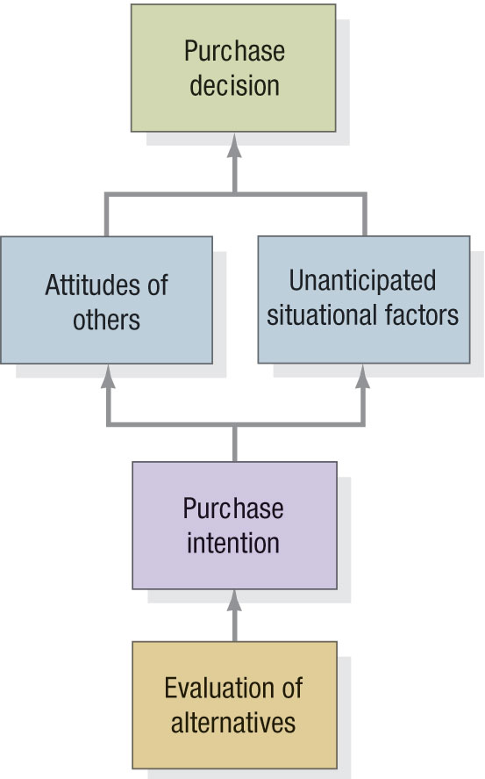
The Buying Decision Process Stage 4: Purchase Decisions
48
Five decisions during actual purchase:
Brand
Source/Shop/Retailer/Dealer
Quantity
Timing
Payment Method
Further Considerations & Different [perceived] risks

Slide 49
The Buying Decision Process Stage 5: Post-Purchase Behavior
49
Impacts future engagement of customer
Post-Purchase Satisfaction
Satisfaction depends on expectation
Post-Purchase Actions
Subsequent re-buy or abandoning (forever may be)
Telling to others
Post-Purchase Use & Disposal
Sales Frequency depends on product consumption rate Quickly finished => Quick re-buying
Also observe how they “dispose” it

Slide 50
Section 3:
Chap 7
What is Organizational Buying
Participants in Business Buying Process
Stages in Buying Process

Slide 51
What is Organizational Buying Business Market vs Consumer Market
51
Fewer, larger buyers
Close supplier-customer relationships
Professional purchasing
Many buying influences
Multiple sales calls
Demand is:
Derived
Inelastic
Fluctuating
Geographically concentrated buyers
Direct purchasing

Slide 52
What is Organizational Buying Buying Situations
52
Suppliers
In-Suppliers: Those who are on approved list and are selling to the company
Out-Suppliers: Those who are trying to penetrate
Buying Situations >>
Straight Re-Buy
Ordering again with same specs
Modified Re-Buy
Revised specs or requirements in any form
New Task
Buying for the first time
Generally to same seller or in-sellers
What can out-sellers do? Offer something “new” to enter
Opportunity for New suppliers – they may be called
Challenge for In-Suppliers
Complete process is carried out starting from developing specs and requirements
Strong evaluations and multiple reviews etc.

Slide 53


What is Organizational Buying Systems Buying and Selling
53
Systems Buying: Buying a complete solution from a supplier/seller
Going for Turnkey solution
May even involve Systems Contracting – Even providing repairing & maintenance as part of sales

Slide 54
Participants in the Business Buying Process The Buying Center
54
Buying Center All those individuals and groups who participate in purchasing decision-making process in any of following roles
Roles:
Initiators: Who request purchase – may be “users”
Users: Who are going to use the product/services directly
Influencers: Who develop specs or influence buying process – technical teams, accounts, finance etc
Deciders: Who decide specs, requirements or suppliers
Approvers: Having authority to approve
Buyers: Who execute the “purchase” process
Gatekeepers: Who can prevent information/suppliers to reach to right person(s)

Slide 55
Participants in the Business Buying Process Buying Center Targeting
55
Buying Center Targeting is all about understanding the buyer – their criterion, their requirements, their processes etc.
Key types of business consumers (understanding preferences)
Price-oriented customers | Transaction Selling Price is everything
Solution-oriented customers | Consultative Selling Going for solution and will listen to arguments for price vs. services/solution
Gold-Standard customers | Quality Selling Want best performance, quality, specs, service etc.
Strategic-value customers | Enterprise Selling Fairly permanent relationship – rather than just a buying activity

Slide 56
Stages in Buying Process
56
Problem Recognition
General Need Description
Product Specification
Supplier Search
Proposal Solicitation
Supplier Selection
Order-Routine Specification
Performance Review

Slide 57
Section 4:
Chap 8
Levels of Market Segmentation
Segmenting Consumer Markets
Market Targeting

Slide 58
Levels of Market Segmentation
58
Mass Marketing is: Mass Production, Mass Distribution and Mass Promotion of one product for all buyers
Picasso pen (standard) Pak Fan standard ceiling fan
BUT…. Mass marketing is becoming difficult as it is not profitable to reach mass audience always
Micro-Marketing is done at one of four levels:
Segments - Segment Marketing
Niches – Niche Marketing
Local Areas – Local Marketing
Individuals - Customerization
This discussion is NOT available in the book as-is
But IS INCLUDED IN COURSE (use slides & class discussion)

Slide 59
Segmenting Consumer Markets Different Segmentation Variables
59
Geographic
Demographic
Age & Lifecycle
Life Stage
Gender
Income
Generation
Social Class
Psychographic
Behavioral
Consumers are divided and it needs to be seen whether they have different preferences towards product or not

Slide 60
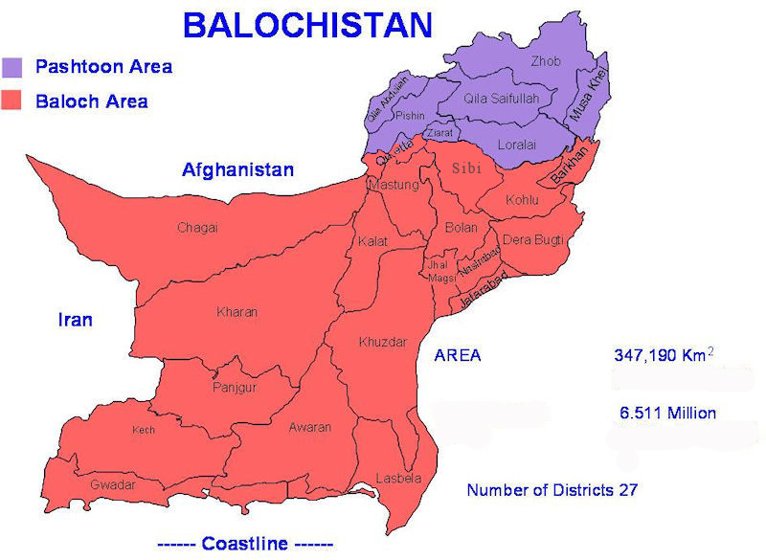
Segmenting Consumer Markets Geographic Segmentation
60
Pakistan – understanding the geography
Class Discussion – take notes! (Your own notes are going to be included)
OWN EXERCISE: Explore other geo-ethnic divisions in the country
[For example:] Special case-in-point
Balochistan’s ethnic division

Slide 61
Segmenting Consumer Markets Demographic Segmentation
61
Age and Life-Cycle Stage
Wants and abilities change with age | Age segmentation can be refined further
Imp. to do it carefully by understanding consumers’ preferences as they change
Life Stage
What events and stages a person goes through in his/her life affects buying behavior
E.g. Users in age group of 50-60 are about to retire from work life and are segmented/targeted for pension plans etc.
Gender
Importance of understanding how they differ in purchasing behavior
How they approach purchase decision is to be observed

Slide 62
Segmenting Consumer Markets Demographic Segmentation
62
Income
Long-standing and established practice
Understanding of exact behaviors is important
Generation
A generation is impacted by lifestyle of times it grows in
Cohorts are formed whose members share same political, cultural and economic experiences. For Example: Profiling of American generation is done famously as: Baby boomers (born: 1946-64) Generation X (born: 1965-77) Generation Y (born: 1978-94) Millennials (born: 1995-2002)
Behaviors are (believed to be) highly coherent
Social Class
Has strong impact on lifestyle, product preferences etc.

Slide 63
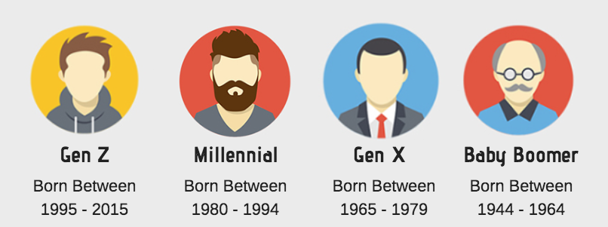
Segmenting Consumer Markets Demographic Segmentation

Slide 64
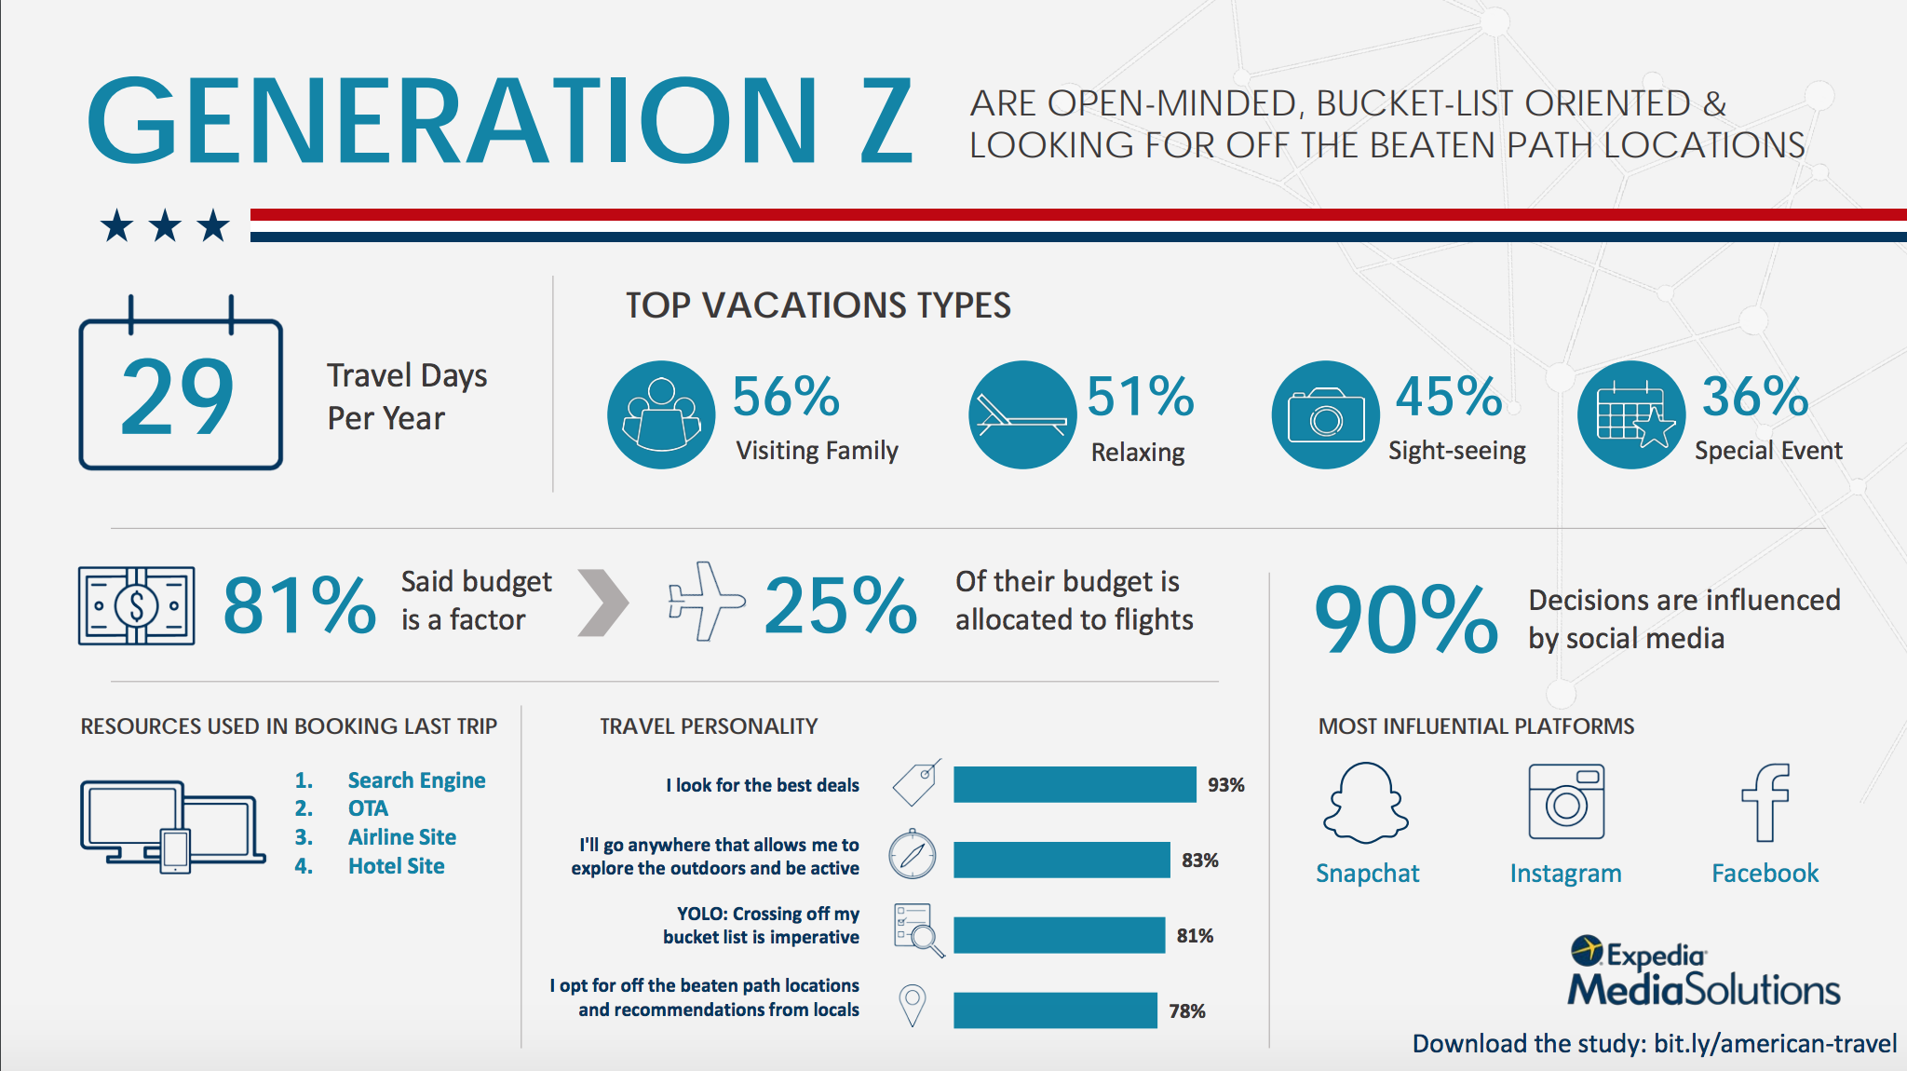
Segmenting Consumer Markets Demographic Segmentation

Slide 65
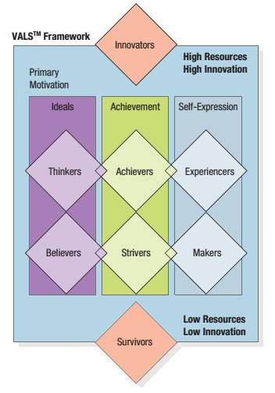
Segmenting Consumer Markets Psychographic Segmentation
65
Psychographic Segmentation is dividing buyers into groups/segments based on:
Psychological / personality traits
Lifestyle
Values
Culture may also play role in Psychographics
A good example is VALS™ model used in the Unites States

Slide 66
Segmenting Consumer Markets Behavioral Segmentation
66
In Behavioral segmentation buyers are divided into groups based on:
Their knowledge of product
Attitude towards product
Use of product
Response to a product
Decision Roles
Who buys what? What influence they have
Consumers may have following roles in buying process (Initiator, Influencer, Decider, Buyer, User etc.)

Slide 67
Segmenting Consumer Markets Behavioral Segmentation
67
Behavioral Variables
Occasions: Activities in different occasions impact needs & purchasing (e.g. holidays, start of month etc.)
Benefits: Based on benefits sought by consumers
User Status: Non-users | Ex-users | Potential Users | First-time users | Regular Users
Usage Rate: Light, medium and heavy users
Buyer-Readiness Stage: Unaware | Aware | Interested | Intend to buy
Loyalty Status: Hard core loyals | Split loyals | Shifting loyals | Switchers
Attitude: Enthusiastic | Positive | Indifferent | Negative | Hostile

Slide 68
Segmenting Consumer Markets Behavioral Segmentation
68
Behavioral Variables (breakdown)
Target Market
Unaware
Aware
Not tried
Tried
Negative opinion
Neutral
Favorable opinion
Rejector
Not yet repeated
Repeated
Loyal to other brand
Switcher
Loyal to brand
Light user
Regular user
Heavy user

Slide 69
Market Targeting
69
Marketers job is to identify segments and select which ones to target
Segments are identified => Now selecting which ones to target
More and more refinement helps identify smaller, more focused segments and Better target them

Slide 70
Market Targeting Effective Segmentation Criteria
70
Market segments must rate favorably on following criteria:
Measurable
Size, purchasing power, characteristics can be measured easily
It should not be vague
Substantial
Large & profitable enough to serve
Worth going after with a tailored marketing program/effort
Accessible
Can be effectively reached and served
Differentiable
Conceptually distinguishable
Respond differently to different marketing-mix elements
Actionable
Effective programs can be formulated for that particular segment

Slide 71
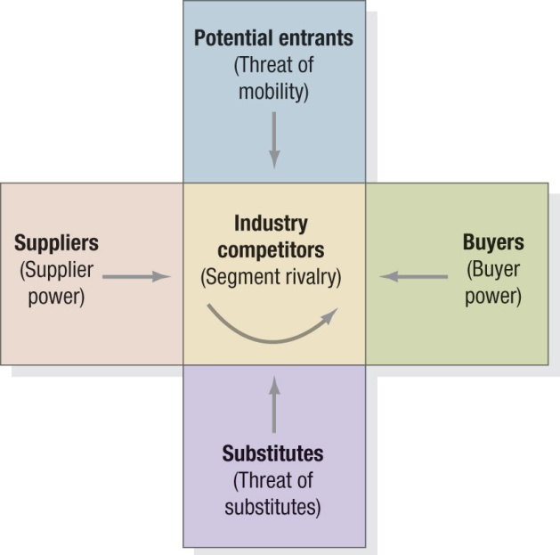
Market Targeting Effective Segmentation Criteria – Competitive Forces
71
Porter’s Five Forces Model
1. Threat of intense segment rivalry INDUSTRY COMPETITORS’ intense rivalry can make a segment unattractive
2. Threat of new entrants
Depending on what kind of entry & exit barriers exist:
If both are high: profits are high and risks are high too
If entry is high but exit is low: firms enter
If both are low: returns are low and stable
3. Threat of substitute products
If there are actual or potential substitute products

Slide 72
Market Targeting Effective Segmentation Criteria – Competitive Forces
72
Porter’s Five Forces Model
Threat of buyer’s growing bargaining power
If buyers possess strong or even growing bargaining power, it can erode margins
Threat of suppliers’ growing bargaining power
If suppliers can raise prices or reduce quantity supplied and have bargaining power it can make an industry unattractive
IMPORTANT CLASS DISCUSSION:
WHY & HOW PORTER’S FORCES MODEL IS USED?
- For industry
- For market and/or market segment

Slide 73
Market Targeting Evaluating and Selecting the Market Segments
73
Choice to be made between going for: Segments (Segment marketing) or Individuals (Customization)
Arguments for/against segmentation concept:
FOR (they favor segmentation): More efficient | Less customer information | More standardization
AGAINST (they favor customization): Segments are fiction | Those in a segment differ greatly

Slide 74
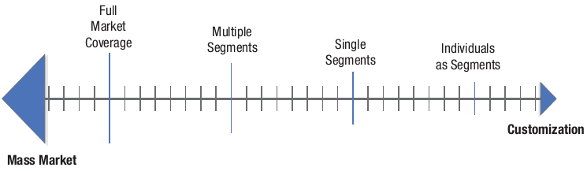
Market Targeting Evaluating and Selecting the Market Segments
74
Evaluation process
Based on five criteria (mentioned previously)
Vis-à-vis two factors:
Segment’s overall attractiveness
Company’s objectives and resources
A company must evaluate segments carefully by answering all criteria clearly and ensuring that it is favorable

Slide 75
Market Targeting Ethical choice of market targets
75
Ensuring that marketing efforts are not exploiting vulnerable groups in society OR promoting harmful products
Children for products of children (Question: Do they understand their own good?)
Targeting children online – information privacy issues
Targeting children is not ALWAYS bad e.g. Lifebuoy’s campaign for washing hands

